Slide 1
Time-Sensitive Networks from Academia to Industry: trends and challenges beyond the hype
Saad Mubeen and Mohammad Ashjaei

Slide 2
Schedulability Analysis
Different classes with different requirements:
  AVB (classes A, B, C, …)
  ST (scheduled offline for determinism)
  BE (no guarantee is needed)
ST is scheduled offline, thus the delays are guaranteed by construction
BE typically does not need any guarantee
AVB needs schedulability analysis to determine whether they meet their requirements
Analysis in RT systems can be:
  Optimistic: unacceptable as it fails to provide safe results
  Pessimistic: safe but leads to waste of resources
  Exact: preferred, but hard to acheive
We aim to reduce the pessimism in the analysis
Notes:
Instead of encapsulating multiple CAN frames in a single TSN frame, a simpler approach is to encapsulate one CAN frame per TSN frame. The main advantage of this strategy is that the CAN frame does not experience the queuing delay that is required to wait for other CAN frames before it can be encapsulated in a TSN frame as in the case of other techniques. Furthermore, this technique is easy to implement and simple to use. In this technique, a CAN Frame is sent to the Ethernet MAC for encapsulation as soon as it arrives at the gateway. The encapsulating TSN frame created has the same period as that of the encapsulated CAN frame. The drawback of this technique is that it can incur a large overhead as the maximum size of a standard CAN frame (encapsulated frame) that uses the maximum data size of 8 bytes is approximately 17 bytes (135 bits), whereas the minimum size of a TSN frame (encapsulating frame) is 64 bytes including the 42-byte header. As a result, padding will be required to meet the minimum length of the TSN frame. Furthermore, this technique cannot utilize the large payloads supported by TSN frames (up to 1500 bytes of payload in a single frame). Another disadvantage is that this technique creates one TSN frame for each CAN frame, which consumes more TSN network bandwidth as compared to other techniques that encapsulate multiple CAN frames in a single TSN frame.

Slide 3
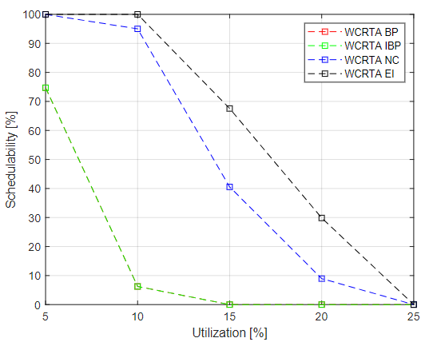
Schedulability Analysis approaches
Here we consider the recent analysis with most of the shapers and multi-hop
Busy Period
Network Calculus
Eligible Interval
“Modeling of Ethernet AVB networks
for worst-case timing analysis,” J. Diemer, J. Rox, and R. Ernst, IFAC, 2012.
“Timing analysis of AVB traffic
in TSN networks using network calculus,” L. Zhao, P. Pop, Z. Zheng, and Q. Li, RTAS, 2018
“Schedulability
analysis of Ethernet AVB switches,”, U. D. Bordoloi, A. Aminifar, P. Eles, and Z. Peng, RTCSA, 2014.
“Latency
analysis of multiple classes of AVB traffic in TSN with standard credit
behavior using network calculus,”, L. Zhao, P. Pop, Z. Zheng, H. Daigmorte, and M. Boyer, TIE, 2020.
“Independent WCRT analysis for individual priority classes in
Ethernet AVB,” Cao, Jingyue and Cuijpers, Pieter JL and Bril, Reinder J and Lukkien,
Johan J, RTS Journal,2018.
“Formal worst-case timing analysis of
Ethernet topologies with strict-priority and AVB switching,” J. Diemer, D. Thiele, and R. Ernst, SIES, 2012.
“Schedulability analysis
of Time-Sensitive Networks with scheduled traffic and preemption
support,”, L. Lo Bello, M. Ashjaei, G. Patti, and M. Behnam, Journal of PDC, 2020.
“An Improved Worst-Case Response Time Analysis
for AVB Traffic in Time-Sensitive Networks,” D. Bujosa, J. Proenza , A. Papadopoulos, T. Nolte, M. Ashjaei, RTSS, 2024.
Notes:
Instead of encapsulating multiple CAN frames in a single TSN frame, a simpler approach is to encapsulate one CAN frame per TSN frame. The main advantage of this strategy is that the CAN frame does not experience the queuing delay that is required to wait for other CAN frames before it can be encapsulated in a TSN frame as in the case of other techniques. Furthermore, this technique is easy to implement and simple to use. In this technique, a CAN Frame is sent to the Ethernet MAC for encapsulation as soon as it arrives at the gateway. The encapsulating TSN frame created has the same period as that of the encapsulated CAN frame. The drawback of this technique is that it can incur a large overhead as the maximum size of a standard CAN frame (encapsulated frame) that uses the maximum data size of 8 bytes is approximately 17 bytes (135 bits), whereas the minimum size of a TSN frame (encapsulating frame) is 64 bytes including the 42-byte header. As a result, padding will be required to meet the minimum length of the TSN frame. Furthermore, this technique cannot utilize the large payloads supported by TSN frames (up to 1500 bytes of payload in a single frame). Another disadvantage is that this technique creates one TSN frame for each CAN frame, which consumes more TSN network bandwidth as compared to other techniques that encapsulate multiple CAN frames in a single TSN frame.

Slide 4
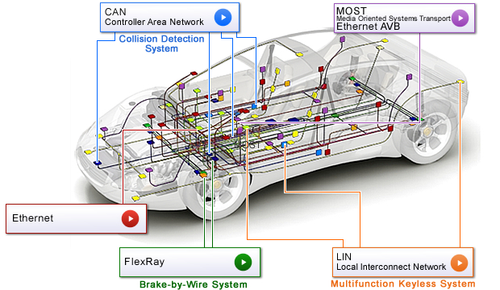
What now?
How do the industry should use the ”mathematics”?
An academic tool?
Industrialized tool?
Software and Systems Development in software engineering
Notes:
Instead of encapsulating multiple CAN frames in a single TSN frame, a simpler approach is to encapsulate one CAN frame per TSN frame. The main advantage of this strategy is that the CAN frame does not experience the queuing delay that is required to wait for other CAN frames before it can be encapsulated in a TSN frame as in the case of other techniques. Furthermore, this technique is easy to implement and simple to use. In this technique, a CAN Frame is sent to the Ethernet MAC for encapsulation as soon as it arrives at the gateway. The encapsulating TSN frame created has the same period as that of the encapsulated CAN frame. The drawback of this technique is that it can incur a large overhead as the maximum size of a standard CAN frame (encapsulated frame) that uses the maximum data size of 8 bytes is approximately 17 bytes (135 bits), whereas the minimum size of a TSN frame (encapsulating frame) is 64 bytes including the 42-byte header. As a result, padding will be required to meet the minimum length of the TSN frame. Furthermore, this technique cannot utilize the large payloads supported by TSN frames (up to 1500 bytes of payload in a single frame). Another disadvantage is that this technique creates one TSN frame for each CAN frame, which consumes more TSN network bandwidth as compared to other techniques that encapsulate multiple CAN frames in a single TSN frame.

Slide 5
Component-based software and system development
Build software systems from pre-existing “elements” called software components
Building components that can be reused in different applications
Maintain systems by replacement of components and introducing new components into the system
Separate development of components from development of systems
Software component C2, implementing function f2, Worst-case execution time WCET2
Input
Ports
Software system or a subsystem
Output
Ports
C1
F1
WCET1
C2
F2
WCET2
Notes:
Instead of encapsulating multiple CAN frames in a single TSN frame, a simpler approach is to encapsulate one CAN frame per TSN frame. The main advantage of this strategy is that the CAN frame does not experience the queuing delay that is required to wait for other CAN frames before it can be encapsulated in a TSN frame as in the case of other techniques. Furthermore, this technique is easy to implement and simple to use. In this technique, a CAN Frame is sent to the Ethernet MAC for encapsulation as soon as it arrives at the gateway. The encapsulating TSN frame created has the same period as that of the encapsulated CAN frame. The drawback of this technique is that it can incur a large overhead as the maximum size of a standard CAN frame (encapsulated frame) that uses the maximum data size of 8 bytes is approximately 17 bytes (135 bits), whereas the minimum size of a TSN frame (encapsulating frame) is 64 bytes including the 42-byte header. As a result, padding will be required to meet the minimum length of the TSN frame. Furthermore, this technique cannot utilize the large payloads supported by TSN frames (up to 1500 bytes of payload in a single frame). Another disadvantage is that this technique creates one TSN frame for each CAN frame, which consumes more TSN network bandwidth as compared to other techniques that encapsulate multiple CAN frames in a single TSN frame.

Slide 6
Benefits
A structured way to develop the vehicle software
Manage the complexity of vehicle software
Allow reuse of software
Legacy software can be encapsuled in the SW architecture
Linking designs directly to requirements (better traceability)
Easier to communicate among the development teams
Perform timing analysis on the software architectures
Software component C2, implementing function f2, Worst-case execution time WCET2
Input
Ports
Software system or a subsystem
Output
Ports
C1
F1
WCET1
C2
F2
WCET2
Notes:
Instead of encapsulating multiple CAN frames in a single TSN frame, a simpler approach is to encapsulate one CAN frame per TSN frame. The main advantage of this strategy is that the CAN frame does not experience the queuing delay that is required to wait for other CAN frames before it can be encapsulated in a TSN frame as in the case of other techniques. Furthermore, this technique is easy to implement and simple to use. In this technique, a CAN Frame is sent to the Ethernet MAC for encapsulation as soon as it arrives at the gateway. The encapsulating TSN frame created has the same period as that of the encapsulated CAN frame. The drawback of this technique is that it can incur a large overhead as the maximum size of a standard CAN frame (encapsulated frame) that uses the maximum data size of 8 bytes is approximately 17 bytes (135 bits), whereas the minimum size of a TSN frame (encapsulating frame) is 64 bytes including the 42-byte header. As a result, padding will be required to meet the minimum length of the TSN frame. Furthermore, this technique cannot utilize the large payloads supported by TSN frames (up to 1500 bytes of payload in a single frame). Another disadvantage is that this technique creates one TSN frame for each CAN frame, which consumes more TSN network bandwidth as compared to other techniques that encapsulate multiple CAN frames in a single TSN frame.

Slide 7

Component-based software and system development
Millions of lines of code
Notes:
Instead of encapsulating multiple CAN frames in a single TSN frame, a simpler approach is to encapsulate one CAN frame per TSN frame. The main advantage of this strategy is that the CAN frame does not experience the queuing delay that is required to wait for other CAN frames before it can be encapsulated in a TSN frame as in the case of other techniques. Furthermore, this technique is easy to implement and simple to use. In this technique, a CAN Frame is sent to the Ethernet MAC for encapsulation as soon as it arrives at the gateway. The encapsulating TSN frame created has the same period as that of the encapsulated CAN frame. The drawback of this technique is that it can incur a large overhead as the maximum size of a standard CAN frame (encapsulated frame) that uses the maximum data size of 8 bytes is approximately 17 bytes (135 bits), whereas the minimum size of a TSN frame (encapsulating frame) is 64 bytes including the 42-byte header. As a result, padding will be required to meet the minimum length of the TSN frame. Furthermore, this technique cannot utilize the large payloads supported by TSN frames (up to 1500 bytes of payload in a single frame). Another disadvantage is that this technique creates one TSN frame for each CAN frame, which consumes more TSN network bandwidth as compared to other techniques that encapsulate multiple CAN frames in a single TSN frame.

Slide 8
Component-based software and system development
Sensor
Actuator
Notes:
Instead of encapsulating multiple CAN frames in a single TSN frame, a simpler approach is to encapsulate one CAN frame per TSN frame. The main advantage of this strategy is that the CAN frame does not experience the queuing delay that is required to wait for other CAN frames before it can be encapsulated in a TSN frame as in the case of other techniques. Furthermore, this technique is easy to implement and simple to use. In this technique, a CAN Frame is sent to the Ethernet MAC for encapsulation as soon as it arrives at the gateway. The encapsulating TSN frame created has the same period as that of the encapsulated CAN frame. The drawback of this technique is that it can incur a large overhead as the maximum size of a standard CAN frame (encapsulated frame) that uses the maximum data size of 8 bytes is approximately 17 bytes (135 bits), whereas the minimum size of a TSN frame (encapsulating frame) is 64 bytes including the 42-byte header. As a result, padding will be required to meet the minimum length of the TSN frame. Furthermore, this technique cannot utilize the large payloads supported by TSN frames (up to 1500 bytes of payload in a single frame). Another disadvantage is that this technique creates one TSN frame for each CAN frame, which consumes more TSN network bandwidth as compared to other techniques that encapsulate multiple CAN frames in a single TSN frame.

Slide 9
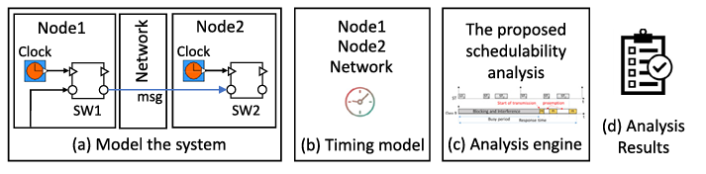
Component-based software and system development
Steps:
  Model the software and system
  Verify the correctness on the model level (high level abstraction)
  No need to implement the code yet
  Timing verification
  Results of the verification
  Update the model if needed
Notes:
Instead of encapsulating multiple CAN frames in a single TSN frame, a simpler approach is to encapsulate one CAN frame per TSN frame. The main advantage of this strategy is that the CAN frame does not experience the queuing delay that is required to wait for other CAN frames before it can be encapsulated in a TSN frame as in the case of other techniques. Furthermore, this technique is easy to implement and simple to use. In this technique, a CAN Frame is sent to the Ethernet MAC for encapsulation as soon as it arrives at the gateway. The encapsulating TSN frame created has the same period as that of the encapsulated CAN frame. The drawback of this technique is that it can incur a large overhead as the maximum size of a standard CAN frame (encapsulated frame) that uses the maximum data size of 8 bytes is approximately 17 bytes (135 bits), whereas the minimum size of a TSN frame (encapsulating frame) is 64 bytes including the 42-byte header. As a result, padding will be required to meet the minimum length of the TSN frame. Furthermore, this technique cannot utilize the large payloads supported by TSN frames (up to 1500 bytes of payload in a single frame). Another disadvantage is that this technique creates one TSN frame for each CAN frame, which consumes more TSN network bandwidth as compared to other techniques that encapsulate multiple CAN frames in a single TSN frame.

Slide 10
Challenges
“An Improved Worst-Case Response Time Analysis
for AVB Traffic in Time-Sensitive Networks,” D. Bujosa, J. Proenza , A. Papadopoulos, T. Nolte, M. Ashjaei, RTSS, 2024.
End-to-end Timing Model
Node
Timing
Model
System Linking Model
Timing
Requirements Model
Analysis
Results
Network
Timing Model
“End-to-end Timing Modeling and Analysis of TSN in Component-Based Vehicular Software,” B. Houtan, et al., ISORC, 2023.
Missing Element
Notes:
Instead of encapsulating multiple CAN frames in a single TSN frame, a simpler approach is to encapsulate one CAN frame per TSN frame. The main advantage of this strategy is that the CAN frame does not experience the queuing delay that is required to wait for other CAN frames before it can be encapsulated in a TSN frame as in the case of other techniques. Furthermore, this technique is easy to implement and simple to use. In this technique, a CAN Frame is sent to the Ethernet MAC for encapsulation as soon as it arrives at the gateway. The encapsulating TSN frame created has the same period as that of the encapsulated CAN frame. The drawback of this technique is that it can incur a large overhead as the maximum size of a standard CAN frame (encapsulated frame) that uses the maximum data size of 8 bytes is approximately 17 bytes (135 bits), whereas the minimum size of a TSN frame (encapsulating frame) is 64 bytes including the 42-byte header. As a result, padding will be required to meet the minimum length of the TSN frame. Furthermore, this technique cannot utilize the large payloads supported by TSN frames (up to 1500 bytes of payload in a single frame). Another disadvantage is that this technique creates one TSN frame for each CAN frame, which consumes more TSN network bandwidth as compared to other techniques that encapsulate multiple CAN frames in a single TSN frame.

Slide 11
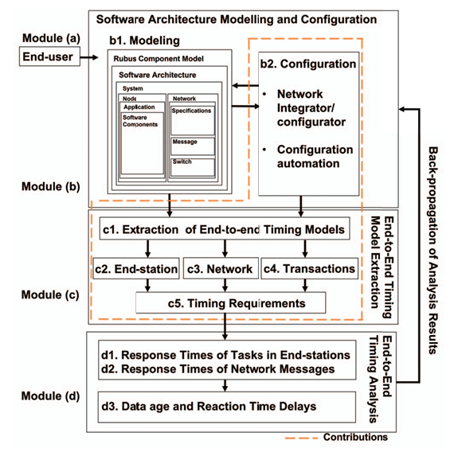
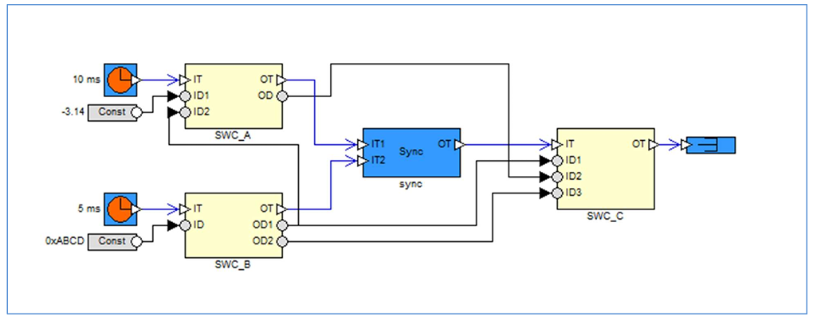
Latest work
For computing RT of a task:
Worst-case execution time
Period and Deadline
Priority
Offset
Notes:
Instead of encapsulating multiple CAN frames in a single TSN frame, a simpler approach is to encapsulate one CAN frame per TSN frame. The main advantage of this strategy is that the CAN frame does not experience the queuing delay that is required to wait for other CAN frames before it can be encapsulated in a TSN frame as in the case of other techniques. Furthermore, this technique is easy to implement and simple to use. In this technique, a CAN Frame is sent to the Ethernet MAC for encapsulation as soon as it arrives at the gateway. The encapsulating TSN frame created has the same period as that of the encapsulated CAN frame. The drawback of this technique is that it can incur a large overhead as the maximum size of a standard CAN frame (encapsulated frame) that uses the maximum data size of 8 bytes is approximately 17 bytes (135 bits), whereas the minimum size of a TSN frame (encapsulating frame) is 64 bytes including the 42-byte header. As a result, padding will be required to meet the minimum length of the TSN frame. Furthermore, this technique cannot utilize the large payloads supported by TSN frames (up to 1500 bytes of payload in a single frame). Another disadvantage is that this technique creates one TSN frame for each CAN frame, which consumes more TSN network bandwidth as compared to other techniques that encapsulate multiple CAN frames in a single TSN frame.

Slide 12

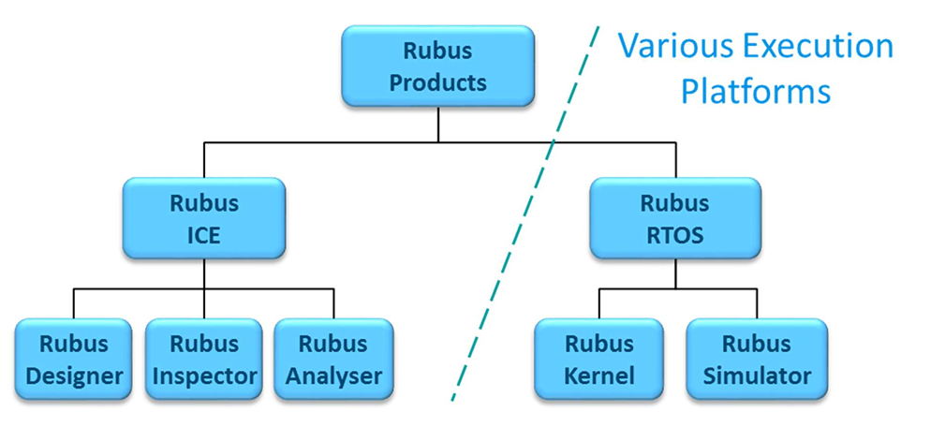
Latest work
https://www.arcticus-systems.com/wp-content/uploads/2023/01/Rubus-Whitepaper.pdf
Notes:
Instead of encapsulating multiple CAN frames in a single TSN frame, a simpler approach is to encapsulate one CAN frame per TSN frame. The main advantage of this strategy is that the CAN frame does not experience the queuing delay that is required to wait for other CAN frames before it can be encapsulated in a TSN frame as in the case of other techniques. Furthermore, this technique is easy to implement and simple to use. In this technique, a CAN Frame is sent to the Ethernet MAC for encapsulation as soon as it arrives at the gateway. The encapsulating TSN frame created has the same period as that of the encapsulated CAN frame. The drawback of this technique is that it can incur a large overhead as the maximum size of a standard CAN frame (encapsulated frame) that uses the maximum data size of 8 bytes is approximately 17 bytes (135 bits), whereas the minimum size of a TSN frame (encapsulating frame) is 64 bytes including the 42-byte header. As a result, padding will be required to meet the minimum length of the TSN frame. Furthermore, this technique cannot utilize the large payloads supported by TSN frames (up to 1500 bytes of payload in a single frame). Another disadvantage is that this technique creates one TSN frame for each CAN frame, which consumes more TSN network bandwidth as compared to other techniques that encapsulate multiple CAN frames in a single TSN frame.

Slide 13
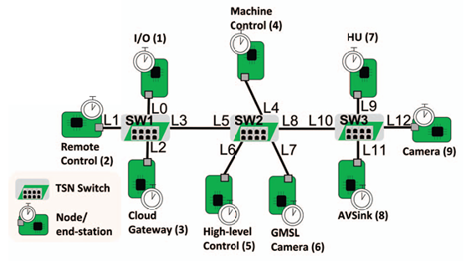
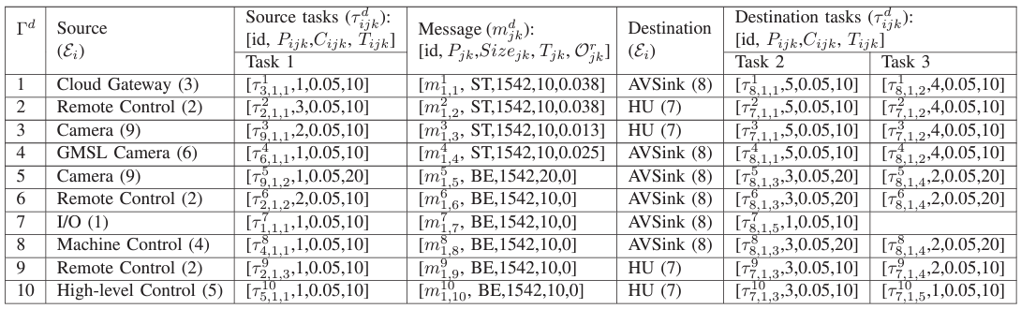
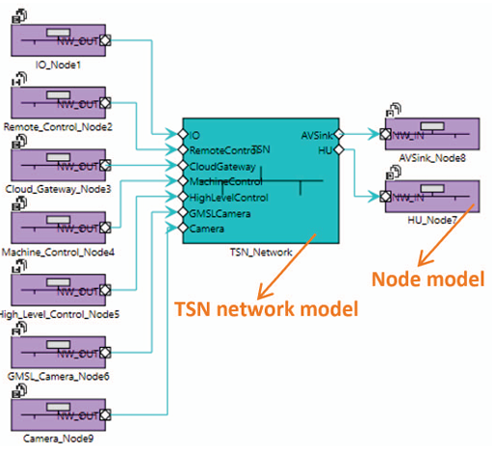
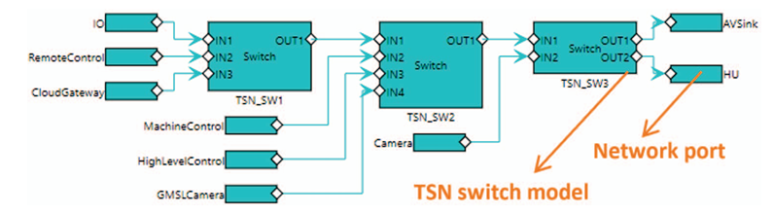
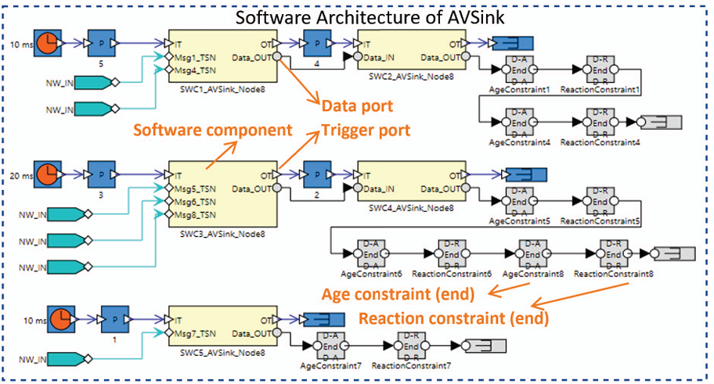
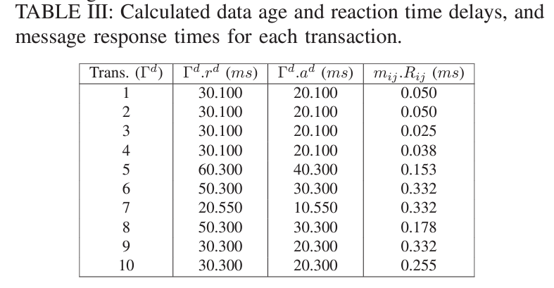
Latest work
Notes:
Instead of encapsulating multiple CAN frames in a single TSN frame, a simpler approach is to encapsulate one CAN frame per TSN frame. The main advantage of this strategy is that the CAN frame does not experience the queuing delay that is required to wait for other CAN frames before it can be encapsulated in a TSN frame as in the case of other techniques. Furthermore, this technique is easy to implement and simple to use. In this technique, a CAN Frame is sent to the Ethernet MAC for encapsulation as soon as it arrives at the gateway. The encapsulating TSN frame created has the same period as that of the encapsulated CAN frame. The drawback of this technique is that it can incur a large overhead as the maximum size of a standard CAN frame (encapsulated frame) that uses the maximum data size of 8 bytes is approximately 17 bytes (135 bits), whereas the minimum size of a TSN frame (encapsulating frame) is 64 bytes including the 42-byte header. As a result, padding will be required to meet the minimum length of the TSN frame. Furthermore, this technique cannot utilize the large payloads supported by TSN frames (up to 1500 bytes of payload in a single frame). Another disadvantage is that this technique creates one TSN frame for each CAN frame, which consumes more TSN network bandwidth as compared to other techniques that encapsulate multiple CAN frames in a single TSN frame.

Slide 14
Takeaway
Aspects to work on:
Most of industrial systems are not only networks
  Schedulability analysis for distributed embedded systems
  Not only TSN, but the effect of tasks
  Data chain, cause-effect chain, etc.
How to integrate the analysis into system development?
  As part of model-based (timing) verification
  Develop methodologies to extract timing information automatically from the model
  Work together with software and system engineers
Notes:
Instead of encapsulating multiple CAN frames in a single TSN frame, a simpler approach is to encapsulate one CAN frame per TSN frame. The main advantage of this strategy is that the CAN frame does not experience the queuing delay that is required to wait for other CAN frames before it can be encapsulated in a TSN frame as in the case of other techniques. Furthermore, this technique is easy to implement and simple to use. In this technique, a CAN Frame is sent to the Ethernet MAC for encapsulation as soon as it arrives at the gateway. The encapsulating TSN frame created has the same period as that of the encapsulated CAN frame. The drawback of this technique is that it can incur a large overhead as the maximum size of a standard CAN frame (encapsulated frame) that uses the maximum data size of 8 bytes is approximately 17 bytes (135 bits), whereas the minimum size of a TSN frame (encapsulating frame) is 64 bytes including the 42-byte header. As a result, padding will be required to meet the minimum length of the TSN frame. Furthermore, this technique cannot utilize the large payloads supported by TSN frames (up to 1500 bytes of payload in a single frame). Another disadvantage is that this technique creates one TSN frame for each CAN frame, which consumes more TSN network bandwidth as compared to other techniques that encapsulate multiple CAN frames in a single TSN frame.

Slide 15
Thank you
Any feedback?

